Slide 1


Faculty of Engineering and Technology
Department of Electrical Engineering
Thesis:
Design and implementation of a warning system for approaching objects to the white cane of the blind
By:
Sepehr , Borzabadi Farahani
972151039
Supervisor:
Ghaznavi-Ghoushchi , Mohamnmad-Bagher , Ph.D.
Summer 2023

Slide 2

preface
Introduction
Table of Contents
Proposed Method
Conclusion
References

Slide 3

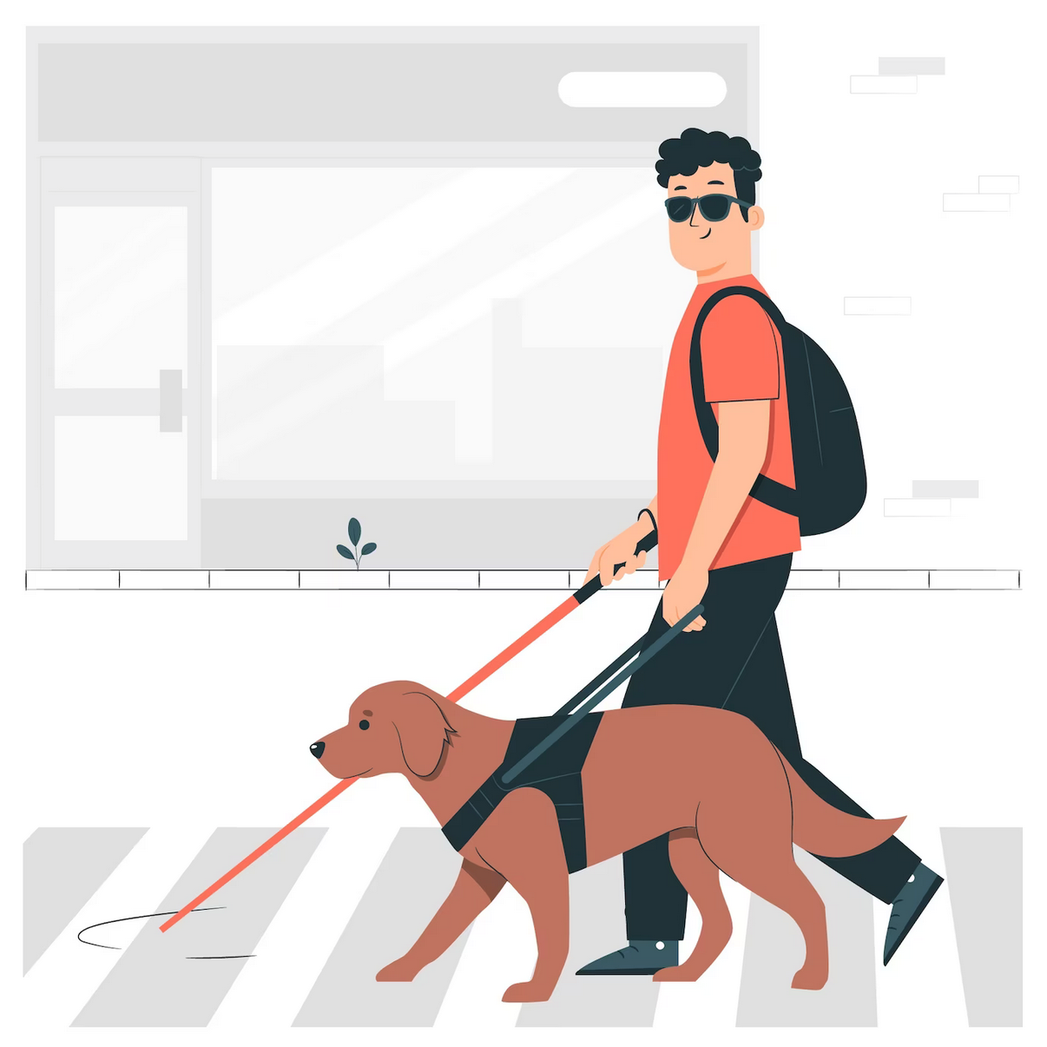
Design and implementation of a warning system for approaching objects to the white cane of the blind
Design and implementation of a warning system for approaching objects to the white cane of the blind
تشخیص سخت یک نابینا در شب
Difficult to recognize a blind person at night
عدم تشخیص دقیق و به موقع موانع در جهت یابی
Improper detection of obstacles in directions
Problems of blind people in daily life:
عدم تشخیص زود هنگام موانع
Failure to detect obstacles early
Failure to notify the user
Failure to recognize obstacles in other directions
1/12
References
Conclusion
Proposed Method
Introduction
preface

Slide 4
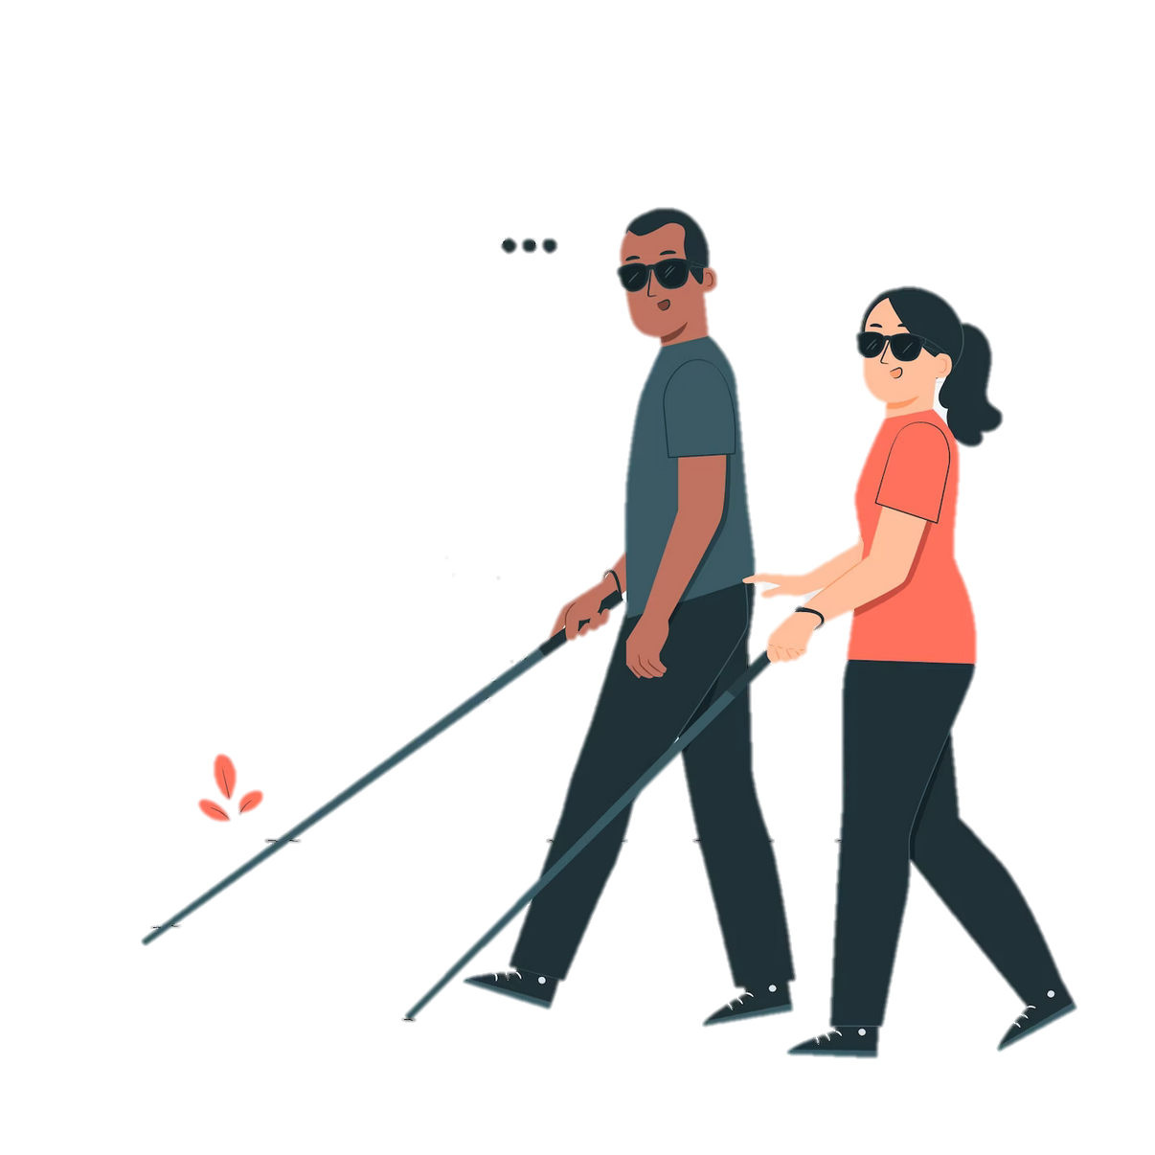
Design and implementation of a warning system for approaching objects to the white cane of the blind
Goals specified in the project:
Accurate detection of obstacles in a specific direction
Early detection of obstacles
Timely notification to the user
Detection of obstacles that are not in contact with the ground
Attracting the attention of a blind person at night
2/12
References
Conclusion
Proposed Method
Introduction
preface

Slide 5

Design and implementation of a warning system for approaching objects to the white cane of the blind
Physical requirements in the design of a smart cane:
Installation of equipment does not cause weakness
Maintain the cane posture
Maintain the weight of the cane
proposed solution
We can design the smart cane in two parts.
3/12
References
Conclusion
Proposed Method
Introduction
preface

Slide 6
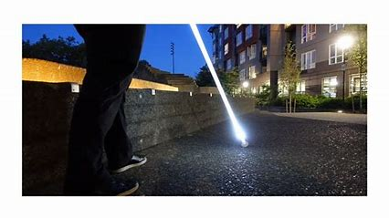
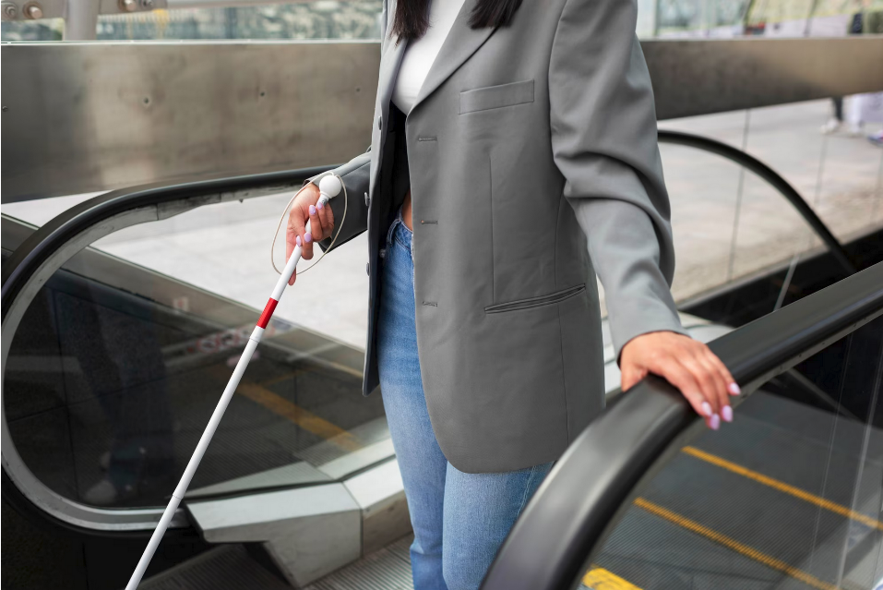
Design and implementation of a warning system for approaching objects to the white cane of the blind
A sign to inform people at night
A special part for night vision to notify other people in the surrounding area
4/12
References
Conclusion
Proposed Method
Introduction
preface

Slide 7
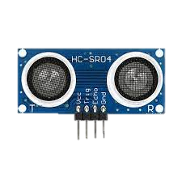
Design and implementation of a warning system for approaching objects to the white cane of the blind
Laser
Types of obstacle detection sensors
Infrared
release
Ultrasonic sensor
reflection
Thru-Beam
5/12
References
Conclusion
Proposed Method
Introduction
preface

Slide 8
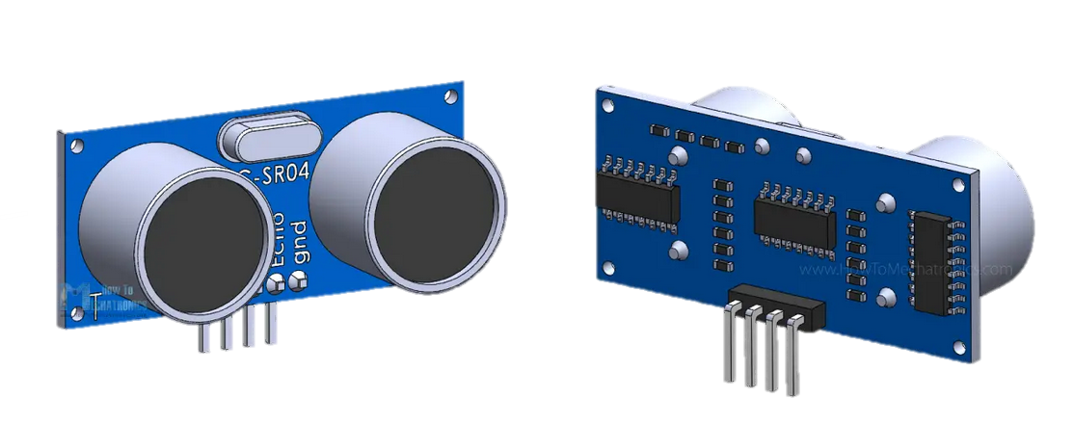
Design and implementation of a warning system for approaching objects to the white cane of the blind
Ultrasonic sensor
fast response
long life
Greater detection range than capacitive and inductive sensors
Correct performance in adverse conditions
Advantages
The presence of a dead zone near the sensor
Failure to recognize small obstacles
Do not use in conditions that cause solid deposits in the sensor
Failure to recognize soft objects
Disadvantages
6/12
References
Conclusion
Proposed Method
Introduction
preface

Slide 9


Design and implementation of a warning system for approaching objects to the white cane of the blind
Audio: Buzzer-speaker
Ways to notify a blind person of an obstacle
Vibrating: vibration motor
Arduino Promini
stm32f103c8t6
Select the processor
esp32
7/12
References
Conclusion
Proposed Method
Introduction
preface

Slide 10
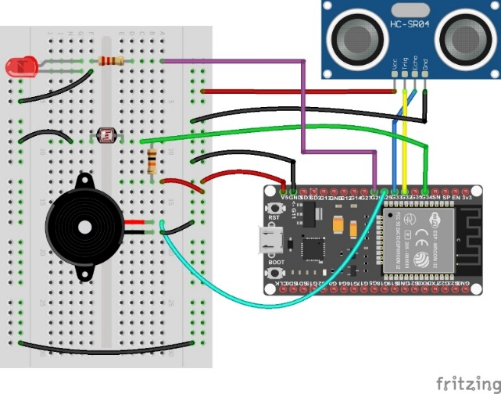
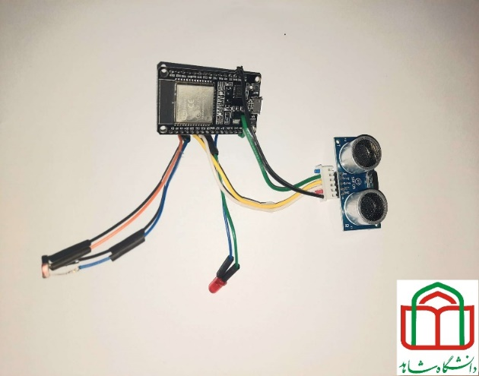
Design and implementation of a warning system for approaching objects to the white cane of the blind
The practical part of the project
Setting up esp32 board by arduino software
Setting up the ultrasonic sensor
Setting up and testing ldr resistance
Setting up and testing bluetooth
1- Setting up and testing each section:
software
hardware
2- Project programming section and equipment installation on the bread board:
Soldering
Installation and placement of system parts
Installing the device box on the cane
3- Assembly and placement of parts:
4- The software part of the project:
8/12
References
Conclusion
Proposed Method
Introduction
preface

Slide 11
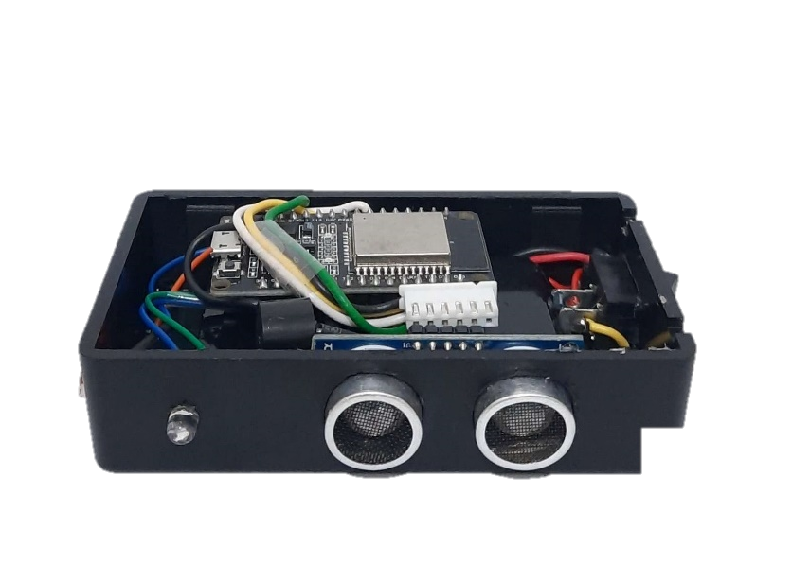
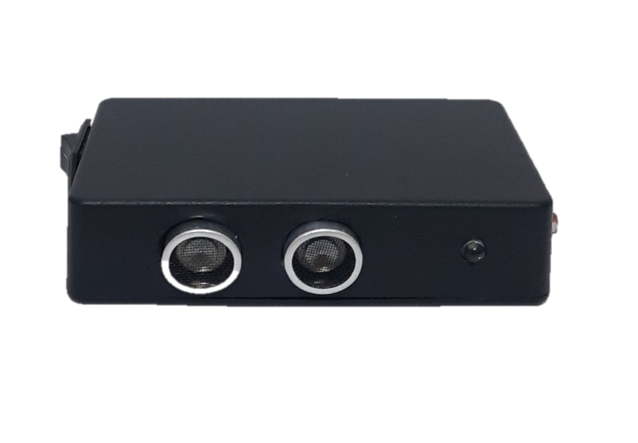
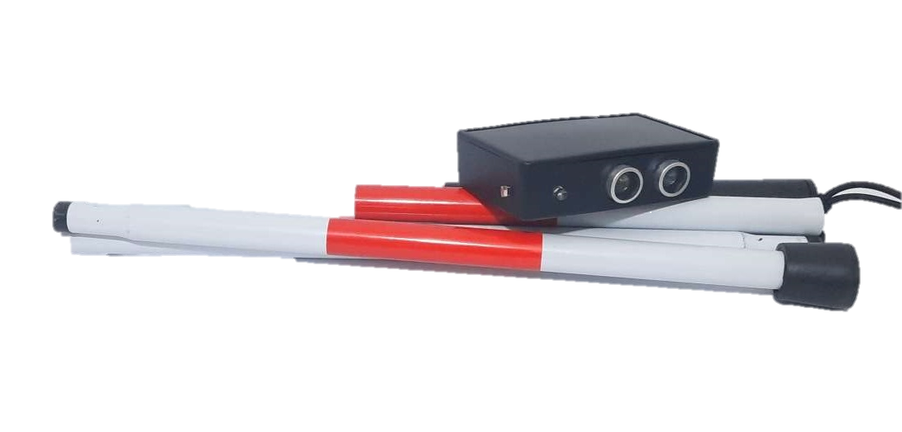
Design and implementation of a warning system for approaching objects to the white cane of the blind
Night detection
Blink led at night
Obstacle detection and distance calculation
Change the beeping of the buzzer according to the distance
Send data via bluetooth to android phone in case of emergency
Demo when the device is turned on
Demo when connecting Bluetooth to phone
software
Ultrasonic sensor
ldr resistance
Buzzer
led
battery
esp32
hardware
9/12
References
Conclusion
Proposed Method
Introduction
preface

Slide 12
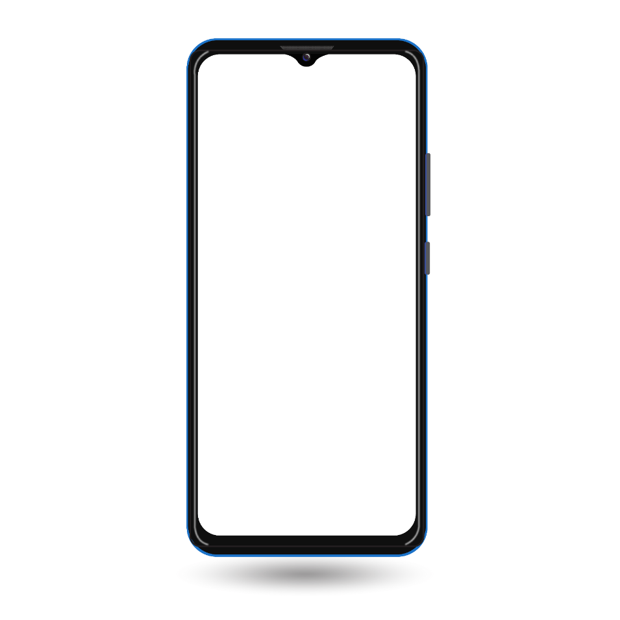
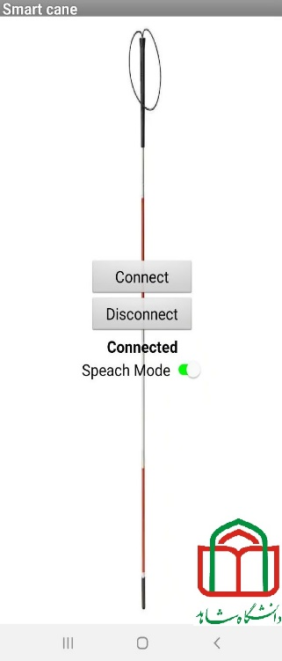
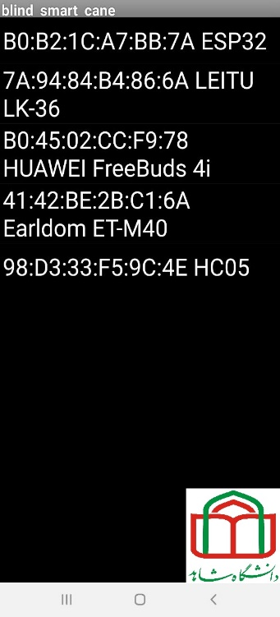
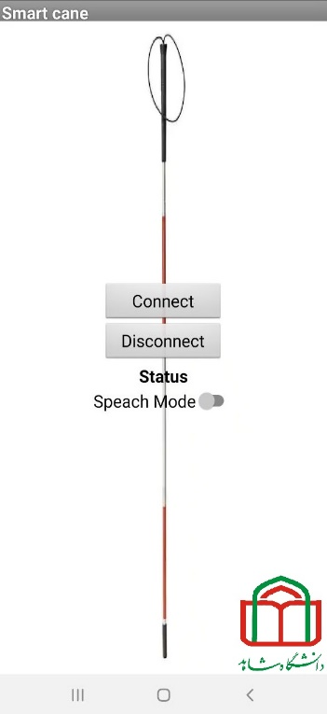
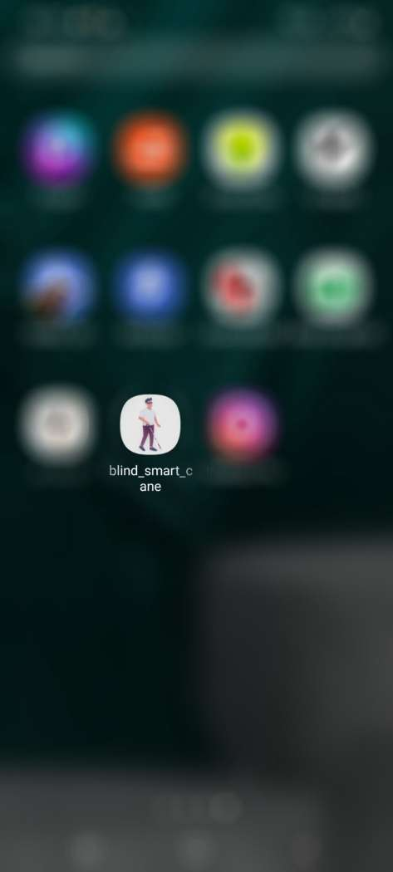
Design and implementation of a warning system for approaching objects to the white cane of the blind
How the Android application works:
10/12
References
Conclusion
Proposed Method
Introduction
preface

Slide 13

Design and implementation of a warning system for approaching objects to the white cane of the blind
Conclusion
Designing a smart cane for the blind to solve the following problems:
Poor communication
Covering a small area of the environment in obstacle detection
Failure to recognize and identify a blind person at night
Failure to recognize the distance between the obstacle and the cane
Failure to recognize obstacles that are not in contact with the ground
Different parts of the smart cane:
ESP32
Ultrasonic sensor for distance measurement
Bazar with different modes to inform about the upcoming obstacle
Light-sensitive resistance to detect dim and dark environments
Android application and notification by vibration and sound
11/12
References
Conclusion
Proposed Method
Introduction
preface

Slide 14

Design and implementation of a warning system for approaching objects to the white cane of the blind
[1] L. Matthies, "Obstacle detection," Computer vision: A reference guide, pp. 1-9, 2020.
[2] F. A. Ghani and A. Zariman, "Smart cane based on IoT," International Journal of Education, Science, Technology, and Engineering, vol. 2, no. 1, pp. 12-18, 2019.
[3] Pawaskar, P.S., D. Chougule, and A. Mali, Smart cane for blind person assisted with android application and save our souls transmission. International Journal of Engineering and Management Research, 2018. 8(3): p. 235-240
[4] M. H. A. Wahab et al., "Smart cane: Assistive cane for visually-impaired people," arXiv preprint arXiv:1110.5156, 2011.
[5] Borenstein J . and U lrich I . T he GuideCane - Applying Mobile Robot Technologies to Assist the Visually Impaired, IEEE Transactions on Systems, Man, and Cybernetics, Part A: Systems and Humans, Vol. 31, No. 2, pp. 131-136, 2001
[6] [Online]. Available: https://irenx.ir/iot/esp-learn/esp32-board-with-arduino/#:~:text=%D9%85%D8%B1%D8%AD%D9%84%D9%87%201%3A%20%D8%A8%D8%B1%D8%AF%20ESP32%20%D8%AE%D9%88%D8%AF,%DA%A9%D8%AF%D8%A7%D9%85%20%D9%BE%D9%88%D8%B1%D8%AA%20%D9%88%D8%B5%D9%84%20%D8%B4%D8%AF%D9%87%20%D8%A7%D8%B3%D8%AA.
[7] [Online]. Available: https://fanamoozan.com/ldr-and-thermistor-rsistor/#:~:text=%D8%B7%D8%B1%D8%A7%D8%AD%DB%8C%20%D8%B4%D8%AF%D9%87%20%D8%A7%D9%86%D8%AF.-,%D9%86%D8%AD%D9%88%D9%87%20%D8%B9%D9%85%D9%84%DA%A9%D8%B1%D8%AF%20%D9%85%D9%82%D8%A7%D9%88%D9%85%D8%AA%20%D9%86%D9%88%D8%B1%DB%8C%20(LDR),%D8%A7%D9%81%D8%B2%D8%A7%DB%8C%D8%B4%20%D9%85%D9%82%D8%AF%D8%A7%D8%B1%20%D8%A7%D9%81%D8%B2%D8%A7%DB%8C%D8%B4%20%D9%85%DB%8C%20%D8%AF%D9%87%D8%AF.
12/12
References
Conclusion
Proposed Method
Introduction
preface

Slide 15


Slide 16


